Slide 1
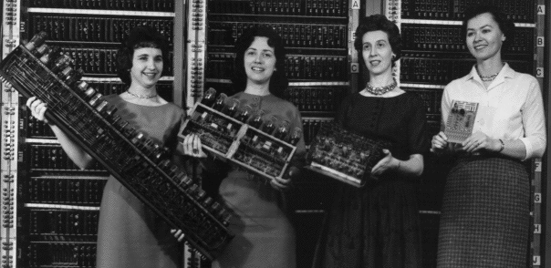
“A Proposal to Improve the Enrollment and Retention of Women in Computer Science”
Patron: Google Educational Grant
Presenter: <NAME HERE>
Presentation Date: 5/1/17, 2:30 pm

Slide 2
Problem
Statistics
US EEOC
Sarah-Jane Leslie
Rosemary Edzie
Reasons why it’s bad
Gender gaps are bad and systemically harm women/minorities
Need women to fill jobs

Slide 3
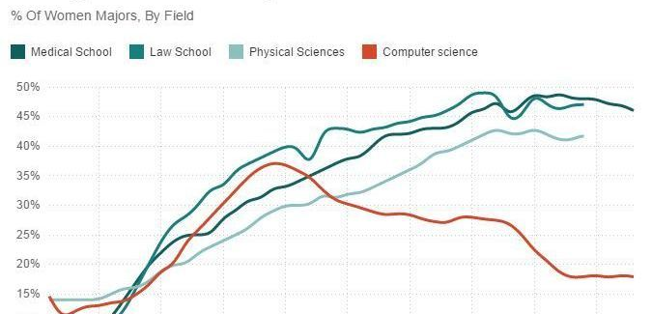
Source: NPR

Slide 4
Population
FRSD stats
Access to CS courses
Interest in CS as a career

Slide 5
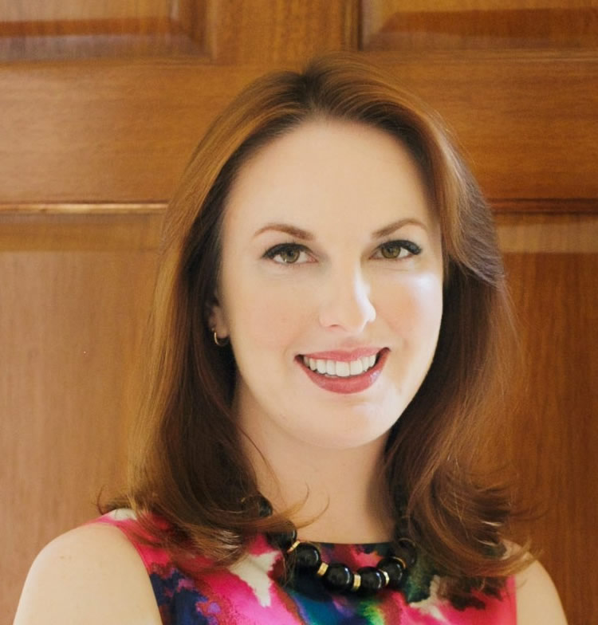
Paradigm 1
Sarah-Jane Leslie
Professor of philosophy and education at Princeton University
Confidence gap

Slide 6
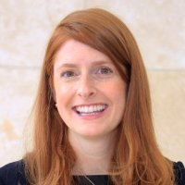
Paradigm 2
Rosemary L. Edzie
University of Nebraska-Lincoln
Societal pressures that prevent women from entering tech

Slide 7
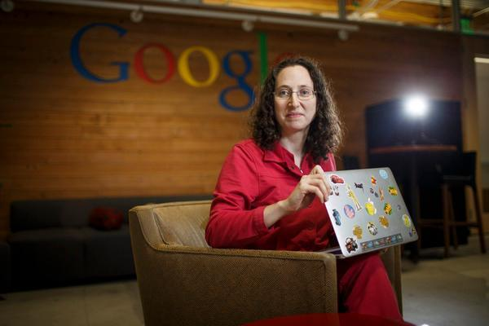
Paradigm 3
Ellen Spertus
MIT
Historically low rates of retention in IT/CSRF

Slide 8

Paradigm 4
Girls Who Code
Plan
Population
Model
Budget
Success

Slide 9
Plan
Afterschool tutoring program for young female students at FRSD
Details:
Held at Manalapan/Freehold Township High School Media Centers (access to computers)
Over course of academic year, starting at the end of October
Funding provided by Google Educational Grant
Teachers provided are volunteers by Rutgers/local colleges

Slide 10
Budget
Laptops
Lenovo M23 Chromebook Laptops ($5370.00)
Transportation
Subsidies for transportation ($1800.00)
Teaching supplies ($300)
Pens, pencils, notepads, etc.
Whiteboards, markers, etc.
TOTAL: ($7500.00)

Slide 11
Schedule
IN 2017
May 21-31; Work with FRSD staff on logistics
June 10 – Sept 30: Advertise program to FRSD students and instructors/mentors at local colleges
Oct 1 – 10: Process applicants
Oct 17 – 25: Announcements
Oct 31: Launch

Slide 12
Impact
Revenue gain
Donors
Money allocation
Increased motivation
Girls Who Code example
Reasons why there is more motivation
Foundation for future tech programs
Grow outreach with more local colleges
Expand on district->state level->interstate level
Future support
Incentive to support is more palatable

Slide 13
Discussion
What do you think of the budget?
What do you think of the motivation/reasons to fight at the middle/high school level?
Do you have any suggestions for improvement?

Slide 14
Works Cited
https://drive.google.com/open?id=0B2ckfm9IIOCCa2VKNTZmMndrTUU

